Slide 1
Hydration, Health and Sports Performance.
Sonali singh assistant prof.j.k.p.[pg]college muzaffarnagar

Slide 2
Meaning of Hydration
Water plays many important roles with in the body and hydration refers simply to the amount of water present. An excess of water (Hyper hydration ) and shortage of water both prevent optimum functioning of body.
keeping the body hydrated is essential for the body to perform basic functions like digestion and absorption of nutrients from food. If the body does not have enough water, the nutrition is mal-absorbed. So all those healthy meals you are eating are all in vain without a glass of water.

Slide 3
Why you need water ?

Slide 4
Role of water in the body
It helps to wash out all the toxins of the body: Water is the most soluble liquid, therefore it has a very important activity in the body; to flush out excess toxins. If the body suffers from a lack of hydration, the kidneys overwork to get rid of the toxins.
your water intake helps regulate enzymatic reaction, muscle activities and disposal of urine and stool from the body .
Water also helps in proper functioning of tissues In order to maintain an electrolytic balance, a well hydrated body is a must.

Slide 6
Hydration and Health

Slide 7
Disease of Dehydration
Constipation
Urinary tract infection and kidney stones
Hypertension, coronary heart disease, stroke
Bladder and colorectal cancer
Heat exhaustion , heat stroke.

Slide 8
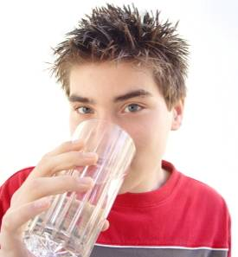
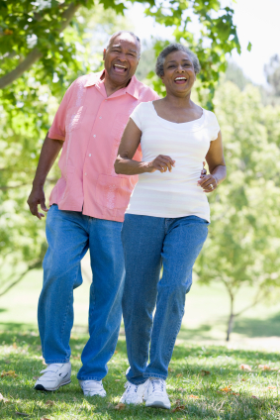
Some people need to drink more
Children
Lactating women
Older adults
Notes:
Children
Children need plenty of fluid.
They should be encouraged to drink regularly and establish a good drinking pattern.
They should drink more when they are being active.
Lactating women
Lactating women require extra fluid for the production of breastmilk.
Older adults
Older people can avoid drinking for physical and social reasons, such as avoiding trips to the toilet.
They may also have a weakened sense of thirst.
They should be encouraged to drink regularly.

Slide 11
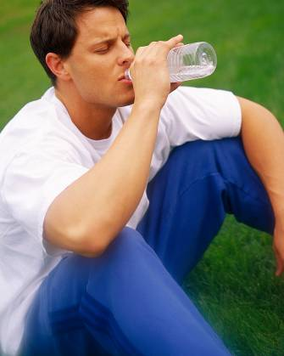
Physical activity
Even slight dehydration has been shown to affect sporting performance, so drink before, during and after you train or play a match.
Being dehydrated may mean that:
running pace is slower;
unable to cover as much distance;
reaction time is slower;
experience lack of power.
Notes:
When you are physically active, your body loses water through breathing and sweating.

Slide 12
Keeping hydrated during exercise
To keep hydrated:
drink lots before exercise;
don’t wait until you feel thirsty;
drink small, regular sips of water during exercise;
drink plenty when you have finished.
The fluid needed for activity is in addition to the 6 to 8 glasses or 1.2 litres needed every day.
It is also important to drink more when the weather is hot.
Notes:
The fluid needed for activity is more than the daily recommendation of 6 to 8 glasses (1.2 litres) each day. So try to keep hydrated during exercise by drinking a lot beforehand, continue to drink small, regular sips during exercise, drink plenty when you have finished; and remember not to wait until you feel thirsty.
Bear in mind also to drink more when the weather is hot.

Slide 14
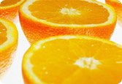
Sports drinks
It is easy to make your own sports drinks at home and cheaper too!
Per 100ml water:
5-8g glucose powder.
0.5g salt.
Any sugar free flavouring.
Notes:
There are many different types of sports drinks available in the market, but making your own sports drink is absolutely doable! Try following this simple recipe:

Slide 15
How hydrated you are?

Slide 16
Monitoring the level of hydration.

Slide 17
Signs of mild dehydration.

Slide 18
Sign of severe dehydration

Slide 19
Skin pinch test for hydration.

Slide 21
Tips for hydration

Slide 22
How much water does a person need?
The amount needed depends on:
age;
climate;
physical activity.
It is generally accepted to drink around 1.2 litres
(6-8 glasses) per day.
This is on top of the water provided by food.
Notes:
The FSA recommends us to drink around 6 to 8 glasses each day, that is approximately 1.2 litres, the amounts should be on top of the water provided by food. We have to drink more when the weather is hot, or if we have been active because we lose water through breathing and sweating.

Slide 23
Tips to proper hydration.

Slide 24
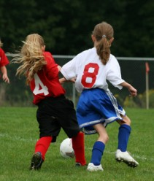
Drinking schedule
A large glass one hour before you start.
A smaller glass 15 minutes before start.
Small sips during the event.
A glass at half time.
A large glass immediately afterwards.
Notes:
A drinking schedule for physical activity could be like this:
Keep yourself hydrated before the training, then have small sips during, some more during break/half-time, then go for a big one immediately afterwards to make sure you replenish the fluid content in your body.
It’s a good habit to drink before, during and after playing sport. It may be uncomfortable at first, but you’ll get used to it.

Slide 25
Be Hydrated
Thank you.

